Slide 1
Various Figures

Slide 2
Some Grid World Pictures

Slide 3
Environment Spec
States: 12 x 8 grid
Temperature: 0.01
Actions: {up, down, left, right}
Noise: 0.3
  E.g., choose “up” go left, right with probability 0.15, up with probability 0.7.

Slide 4
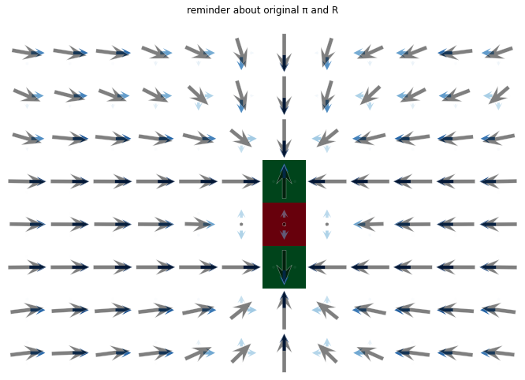
A Grid World
Squares: Rewards.
Vectors: (soft) optimal policy

Slide 5
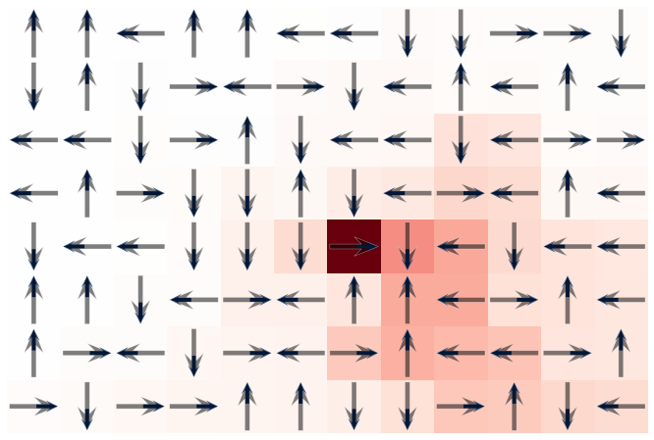
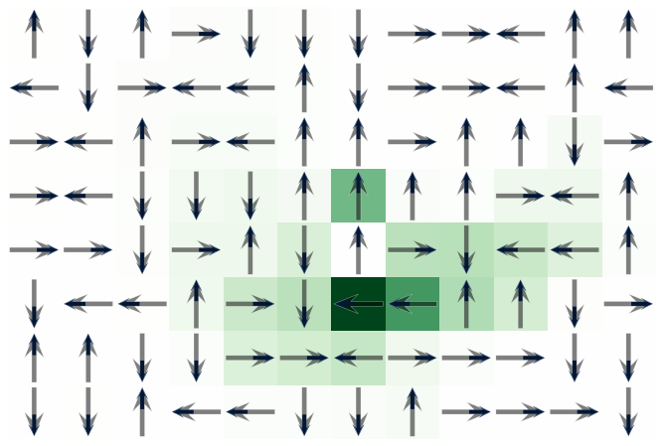
Random Policies + Value Functions
(Deterministic)

Slide 6
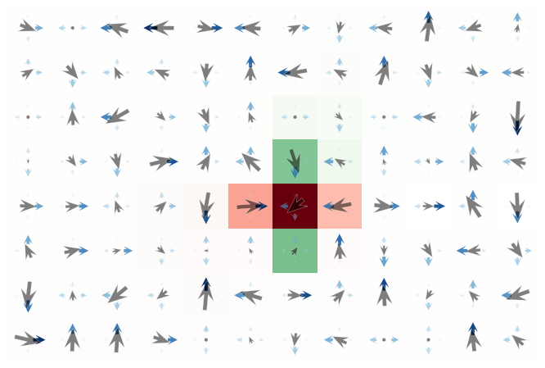
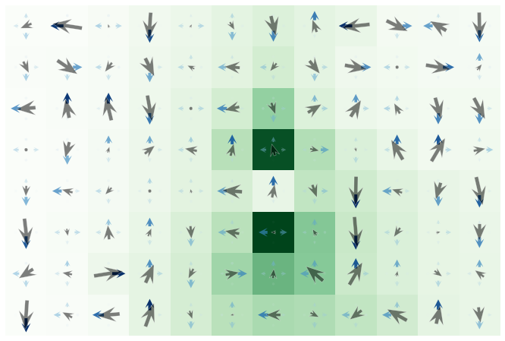
Random Policies + Value Functions
(stochastic)

Slide 7
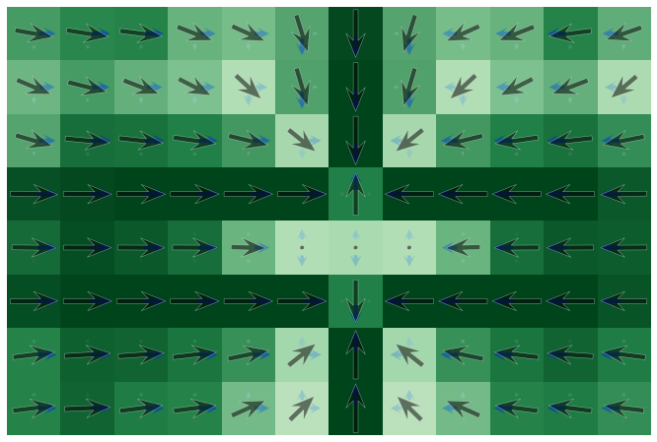
Representing Policy via Reward Function

Slide 8
Comparing Policies

Slide 9
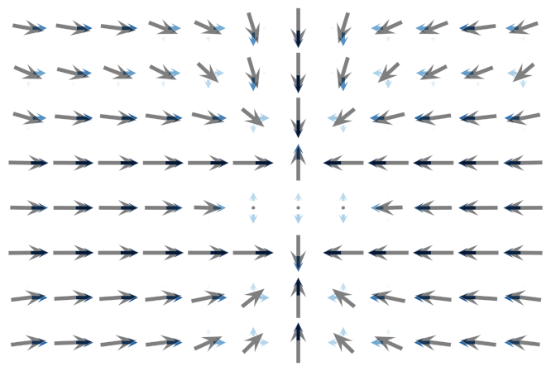
Original Policy

Slide 10

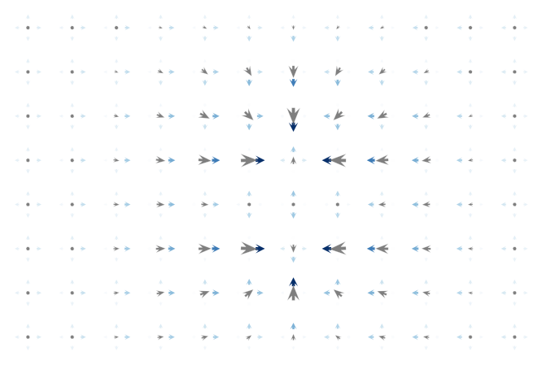

Slide 11

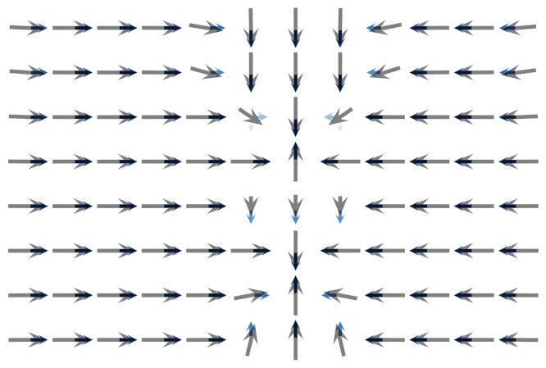

Slide 12
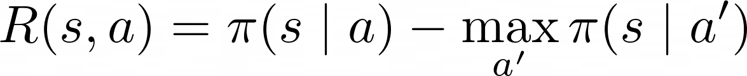
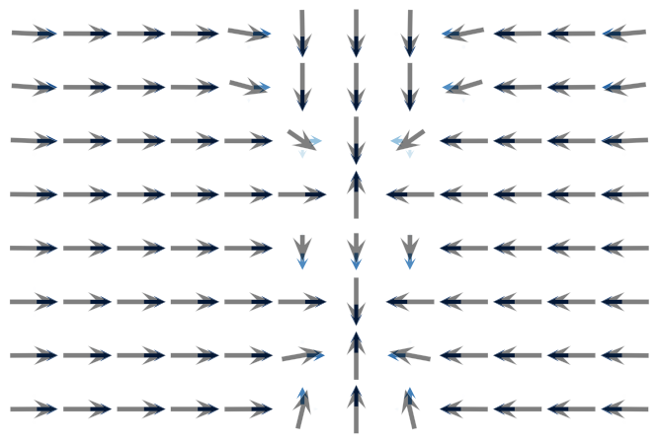

Slide 13
Comparing Value Functions

Slide 14
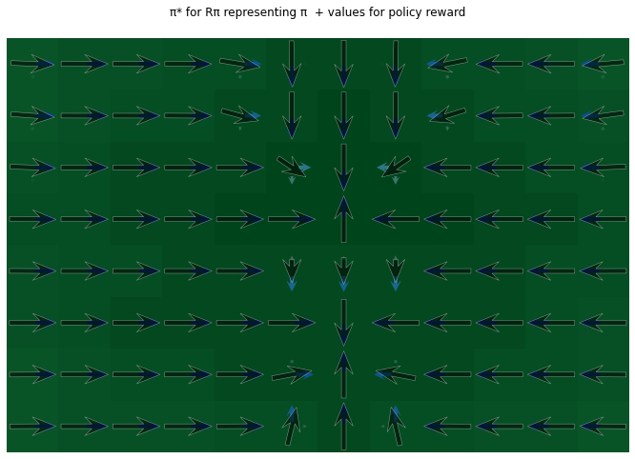
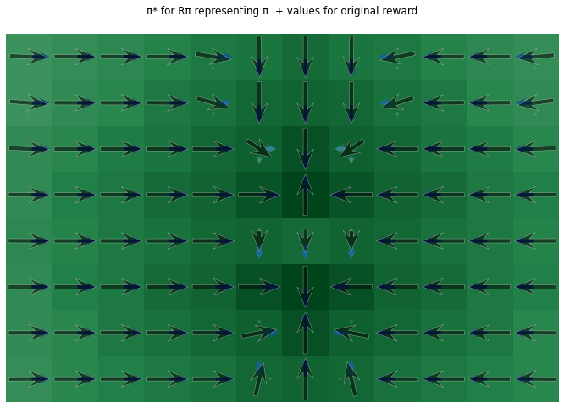
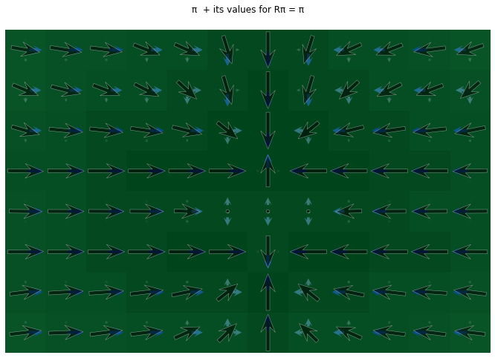
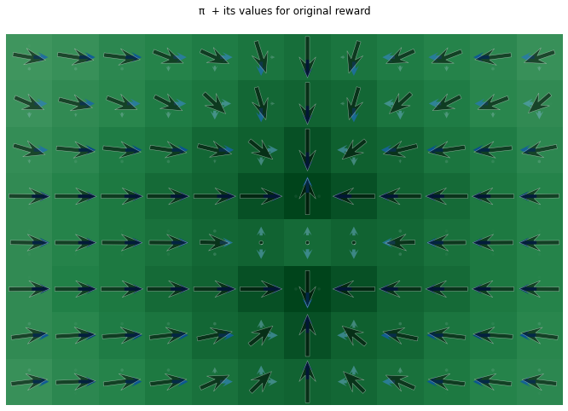


Slide 15
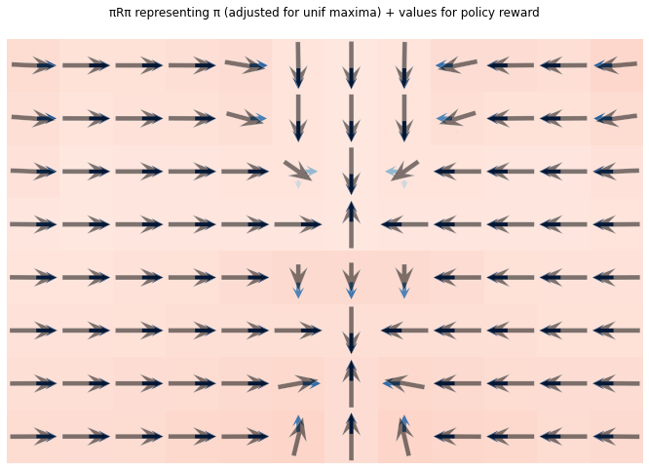
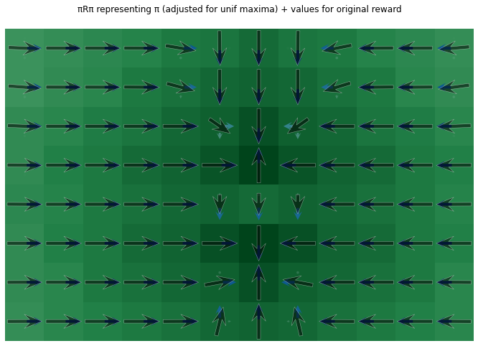

Slide 16
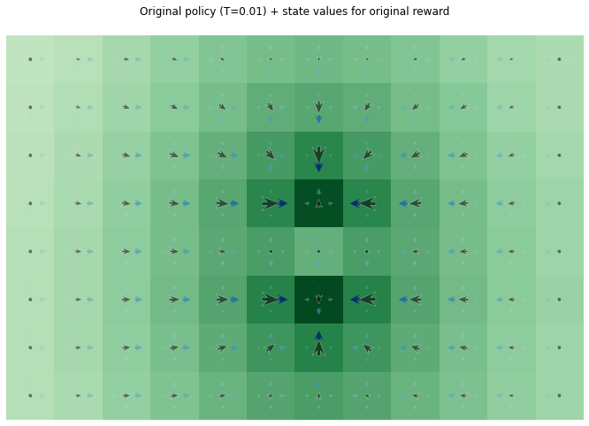
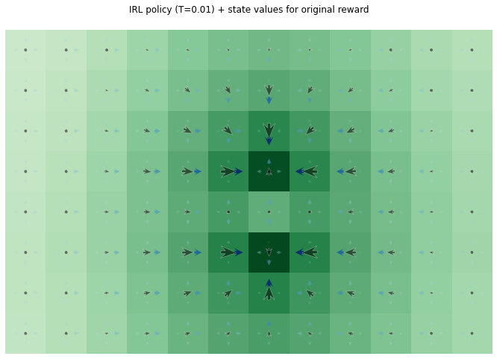

Slide 17
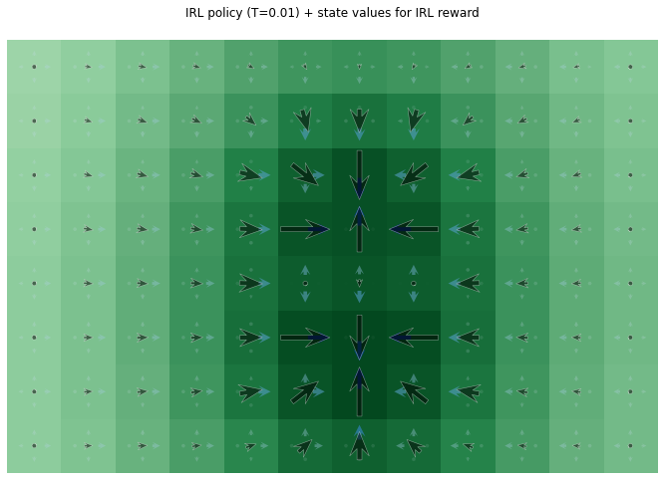
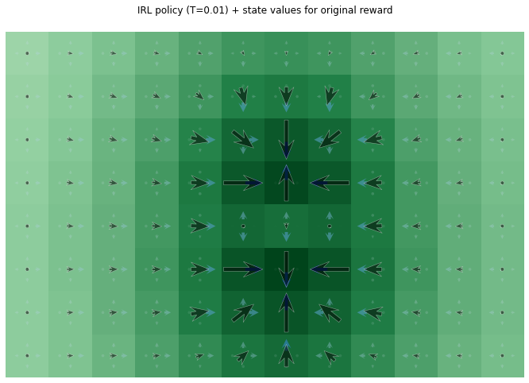
IRL Policy: State Values with respect to…
IRL Reward
Original Reward

Slide 18
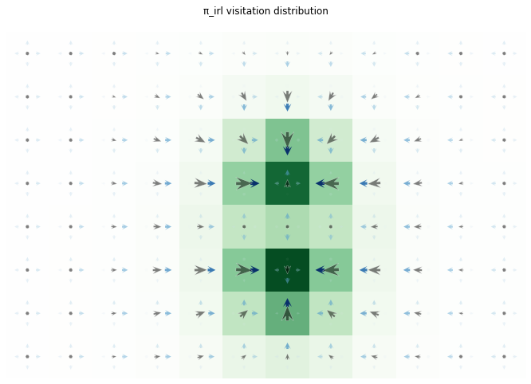

Visitation Distributions

Slide 19
Ideas

